Slide 1

Cardiac Arrest Prediction Using Machine Learning

Slide 2
Project Team
1187
1196
SARTHAK JAGDALE
VIPUL SINGH
1180
RAVI KUMAR
1159
AKSHAT JHA
Mentor: Dr. Rinky Sha

Slide 3


OVERVIEW
MOTIVATION
CARDIAC ARREST
UNIQUENESS
WORKFLOW
RESEARCH
DATASET
RESULT & CONCLUSION

Slide 4
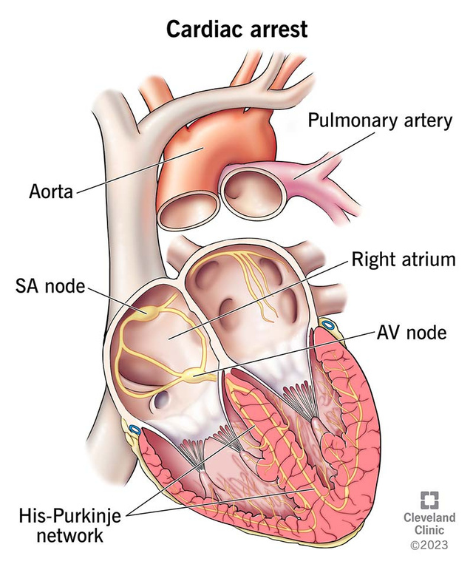
MOTIVATION FOR THIS PROJECT
The motivation for choosing this project is to apply Machine Learning and Deep Learning to a meaningful, real-world healthcare problem.
In India, 1 out of 4 deaths is related to heart diseases
Cardiac arrest causes ~7 million deaths globally every year
Over 70% cases occur outside hospitals
ML helps in early risk identification

Slide 5
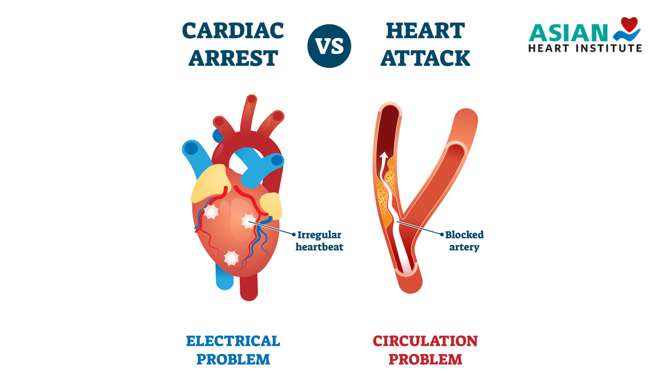
CARDIAC ARREST
Sudden failure of heart’s electrical activity
Stops blood circulation immediately
"Ventricular fibrillation — a chaotic, disorganized electrical rhythm — is the most common cause of sudden cardiac arrest
"Every minute without CPR reduces survival chances by approximately 10%, making bystander response the most critical factor in saving a life."
"Unlike a heart attack, cardiac arrest strikes without warning and becomes fatal within minutes

Slide 6

Technology Used
Python for implementation
Machine Learning Models (LR / RF / SVM)
Libraries: NumPy, Pandas, Scikit-learn
Visualization: Matplotlib, Seaborn
Dataset : Kaggle

Slide 7

What Makes It Unique?
Early-stage risk prediction
Multi-parameter data-driven approach
High accuracy with ML algorithms
Supports clinical decision-making
Reduces human error

Slide 8
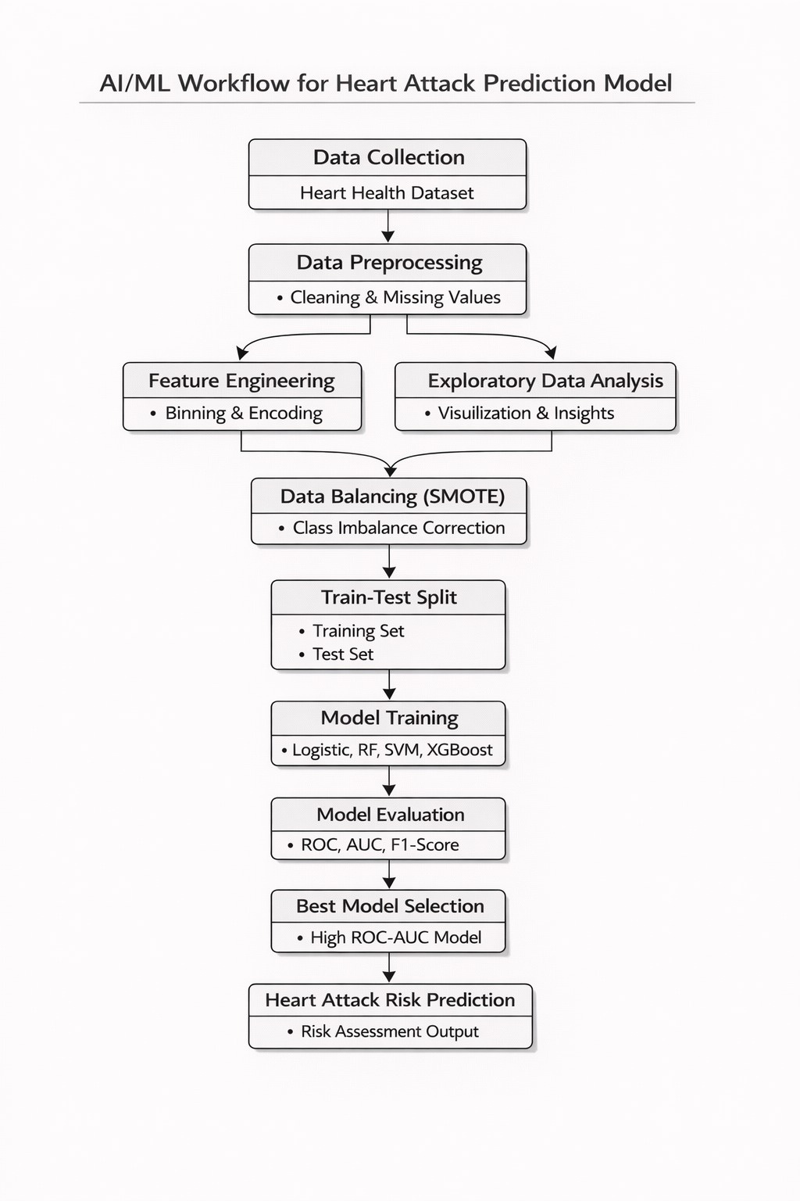
WORKFLOW

Slide 9
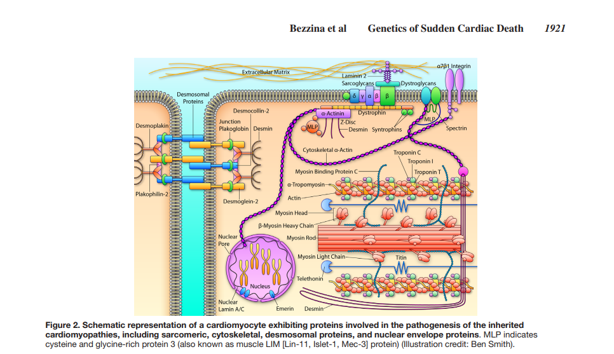
RESEARCH

Slide 10
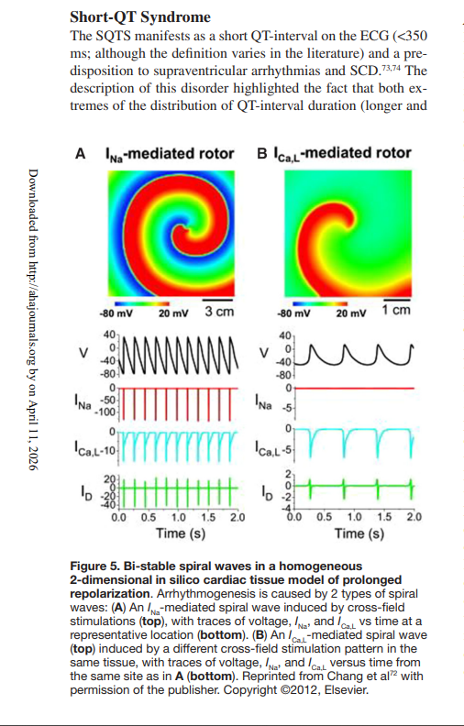

Slide 11
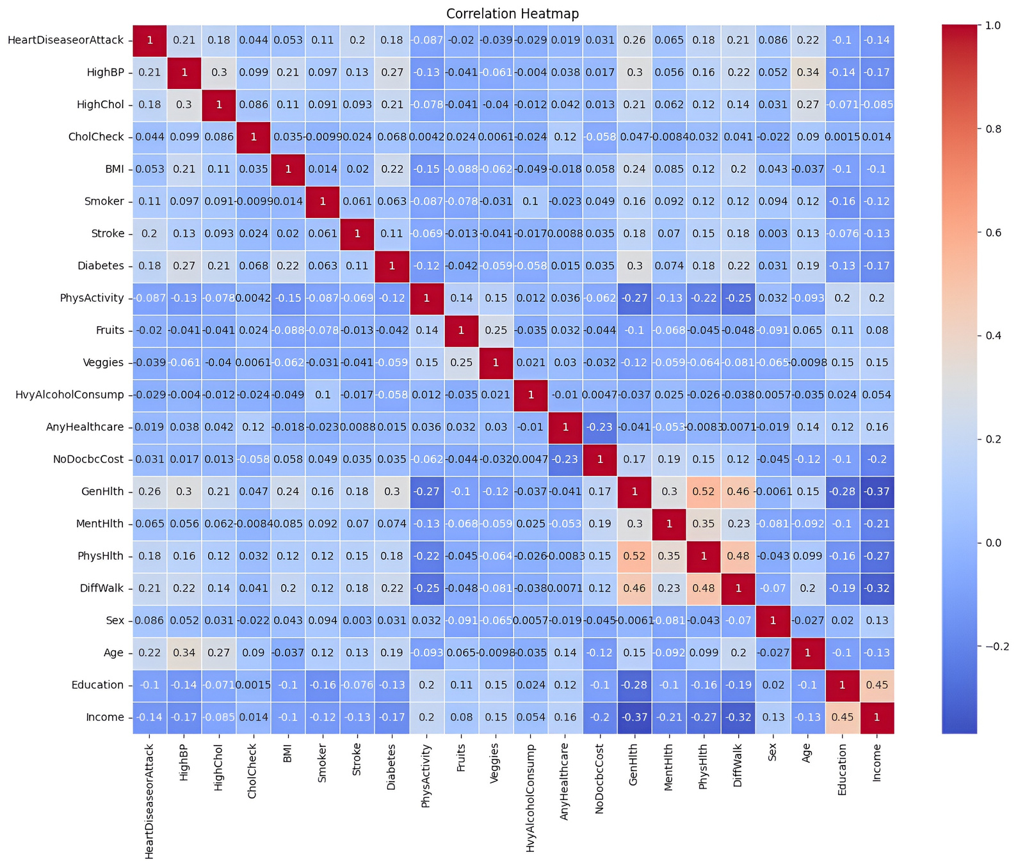
Correlation Heatmap

Slide 12
DATASET

Slide 13
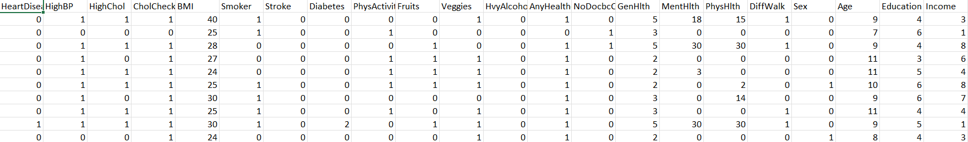
The dataset comprises information from 253,662 individuals.
It includes parameters like high BP, high cholesterol, cholesterol check, BMI, Stroke, Diabetes, gender, age, health history.

Slide 14
RESULTS

Slide 15
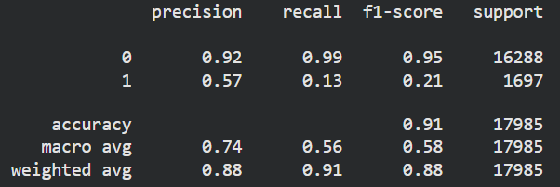
Using Logistic Regression algorithm
Logistic Regression is a supervised machine learning algorithm used for binary classification problems, such as predicting the presence or absence of heart disease.
It estimates the probability of a class using a sigmoid function and outputs results between 0 and 1 for decision making.

Slide 16
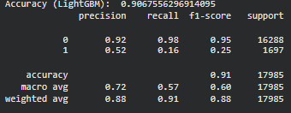
LightGBM (Light Gradient Boosting Machine), along with SMOTE
LightGBM is a gradient boosting algorithm that builds multiple decision trees sequentially to improve prediction accuracy and handle large datasets efficiently.
SMOTE (Synthetic Minority Oversampling Technique) is used to balance imbalanced data by generating synthetic samples for the minority class.

Slide 17
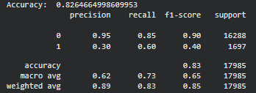
Random Forest Classifier, along with SMOTE
Random Forest is an ensemble learning algorithm that builds multiple decision trees and combines their outputs to improve accuracy and reduce overfitting.
SMOTE is used to balance the dataset by generating synthetic samples for the minority class, improving model performance on imbalanced data.

Slide 18
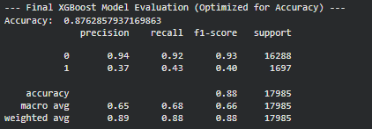
XGBoost (Gradient Boosting)
XGBoost is an advanced gradient boosting algorithm that builds optimized decision trees sequentially to achieve high accuracy and speed.
SMOTE is applied to balance the dataset by generating synthetic samples for the minority class, improving classification performance.

Slide 19
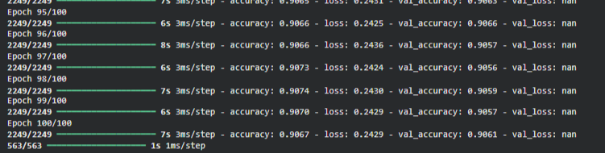
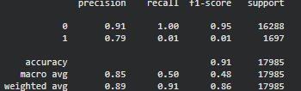
Artificial Neural Network (ANN)
Artificial Neural Network (ANN) is a deep learning model inspired by the human brain, consisting of multiple layers of neurons to learn complex patterns in data.
It uses activation functions like ReLU and Sigmoid, along with backpropagation, to optimize weights and perform accurate binary classification.

Slide 20
Conclusion
Machine learning can significantly improve early detection of cardiac arrest risk
Our model demonstrated promising accuracy in predicting high-risk patients
Timely prediction can reduce mortality rates and enable faster clinical response
The system proves ML has strong potential in life-critical healthcare applications
With further training and data, the model can be deployed in real-world clinical settings

Slide 21
Future Scope
Real-time prediction using wearable devices like smartwatches and ECG patches
Integration with hospital EHR systems for continuous patient monitoring
Deep learning models (LSTM/CNN) for improved time-series ECG analysis
Mobile app development for instant risk alerts to patients and doctors
Federated learning to train models across hospitals without sharing patient data

Slide 22
REFERENCES
DATASET
https://github.com/kaggle/docker-python
RESEARCH
https://doi.org/10.1161/CIRCRESAHA.116.304030

